Slide 1
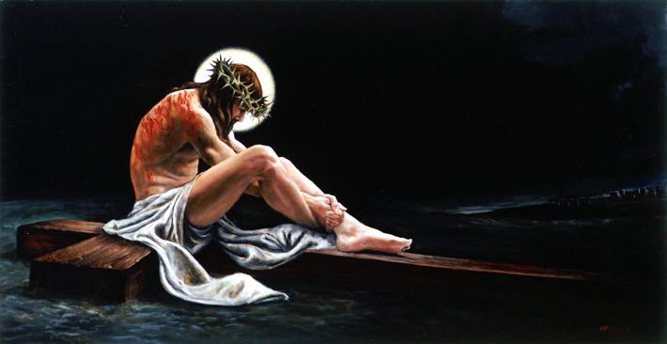
Praying Like Jesus (John 17)
Jesus Finishes Preparing the Disciples for His Absence
Last Discourse Part 4
Dr. Rick Griffith • Crossroads International Church • BibleStudyDownloads.org

Slide 2
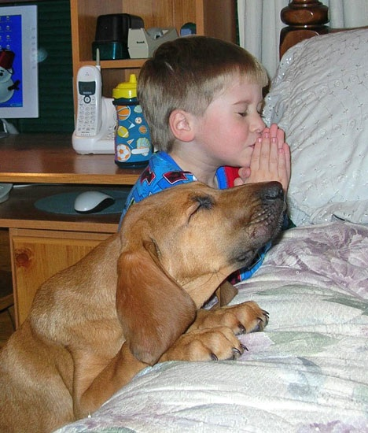
Pray Fervently
“For where two or three are gathered in my name…”
(Matthew 18:20)

Slide 3
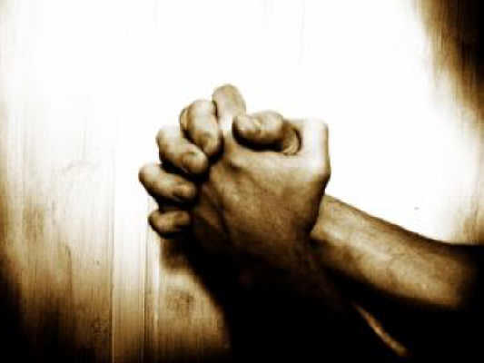
What do you pray for?

Slide 4
Like Jesus?

Slide 5
Overview of John's Gospel
107
Deity Made Man for Eternal Life
Deity of the Son of God | Revelation of the Son of God |  | Preparation of the Son's Disciples | Passion & Resurrection of the Son of God | Adequacy of the Son of God
1:1-18 | 1:19–12:50 |  | 13–17 | 18–20 | 21
Prologue | Public |  | Private | Public | Private
Incarnation | 2 Signs Received 1:19–4:54 | 5 Signs Rejected 5–12 | Upper Room Discourse (no signs) | Ultimate Sign | Last Sign
Eternity Past | Fall AD 29- Monday, 30 March 33 |  | Thursday, 2 April 33 | Friday, 3 April 33- Sunday, 5 April 33 | May, AD 33
Ephesus (AD 65-69)

Slide 6
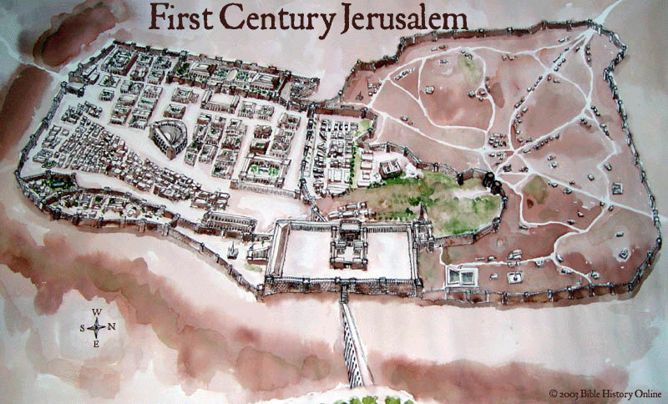
Jerusalem from the East, AD 33
John 13–14 Passover at Mark's House
John 15–16 Vineyard
John 17 Prayer
Kidron Brook
John 18 Mt. of Olives
Notes:
Today we finish what has often been called the Upper Room Discourse—the last time Jesus taught his disciples. This actually isn't a good term to describe all of John 13–17 because at the end of John 14, Jesus noted, “Come, let's be going.”
So they left the upper room of the Passover and began walking east to the Mt. of Olives where he would be betrayed. This likely brought him through a vineyard where he taught in John 15 that he was the vine and, as branches, they needed connection to him.
In John 18:1, they would cross the Kidron Valley, so they are still on the west side of the Kidron Brook. In this ravine lay a channel that led from the temple—not a waterway like an aqueduct—but rather a channel that led from the temple altar where an estimated 256,000 lambs were slaughtered during the Passover. When Jesus crossed it, no doubt the smell of blood was ominously hanging in the air—a picture of what was to happen the next day with Jesus as our Passover Lamb.

Slide 7
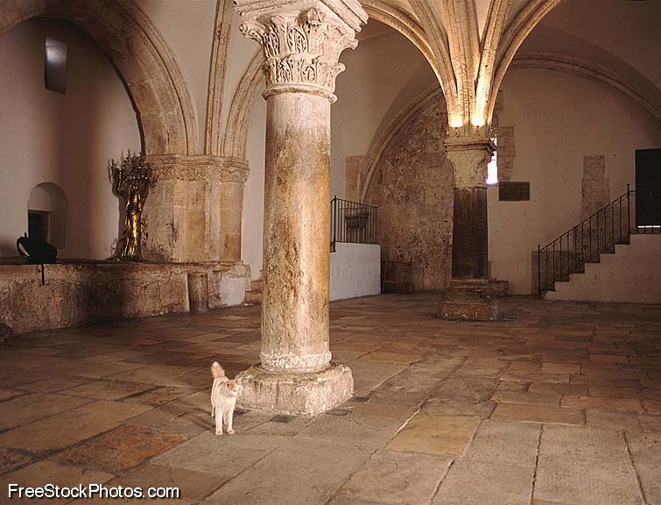
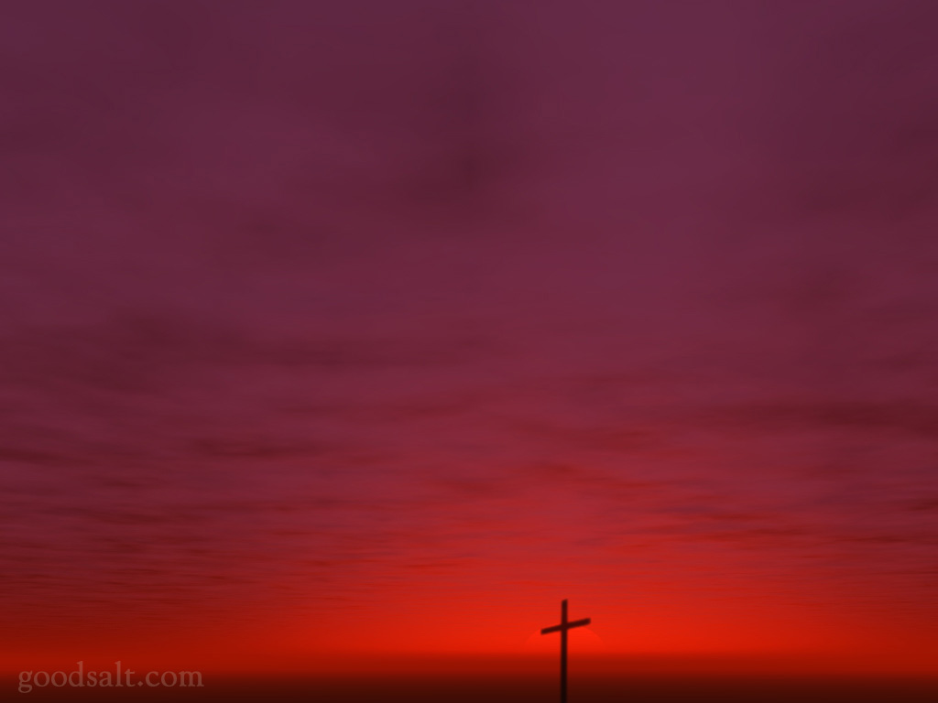
Christ's Prayer in John 17
“There is no voice which has ever been heard, either in heaven or in earth, more exalted, more holy, more fruitful, more sublime, than the prayer offered up by the Son to God Himself.”
––Philip Melanchthon

Slide 8
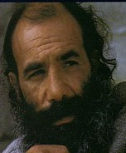
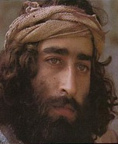
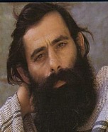
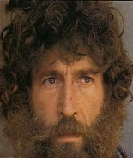
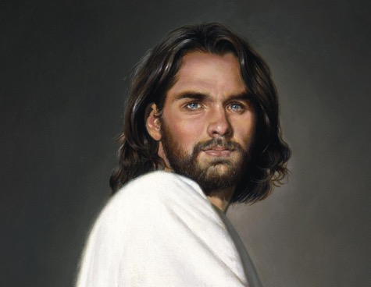
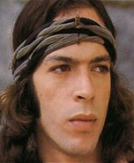
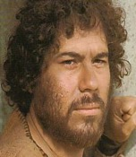
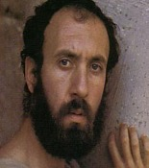
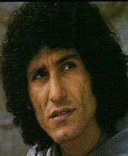
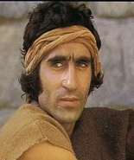
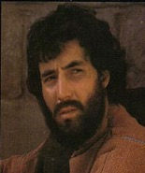
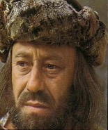
Widening Circle of Christ's Prayer
James
Thaddeus
John
Peter
Andrew
For Himself
Bartholomew
James bar Alphaeus
For Disciples
Thomas
Simon the Zealot
Philip
Matthew
For All Believers

Slide 9
A Pattern for Prayer
Finally pray for those outside your influence
Then pray for those in your closest sphere of influence
First pray that you are in God's will

Slide 10
A Pattern for Prayer
I. Pray that you will glorify God by fulfilling his calling for you.

Slide 11
Widening Circle of Christ's Prayer
For Himself

Slide 12
“The time has come. Glorify your Son…” (17:1)
“You granted him authority… [to] give eternal life” (17:2)
“I have brought you glory by completing the work you gave me to do” (17:4)

Slide 13
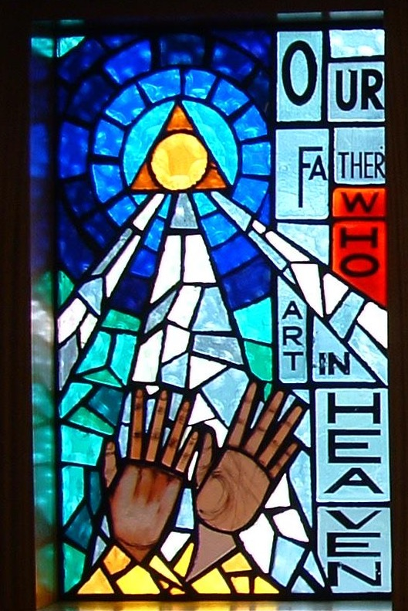
Our Father in Heaven

Slide 14
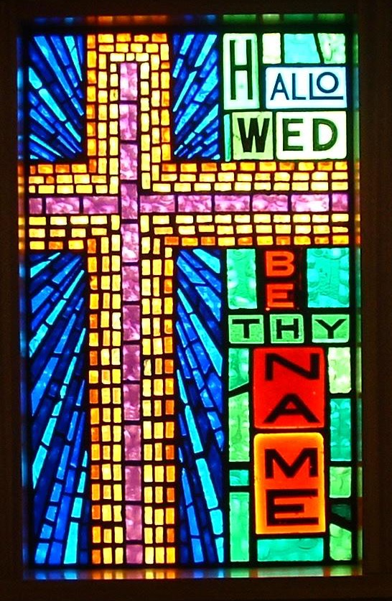
Hallowed Be Your Name

Slide 15
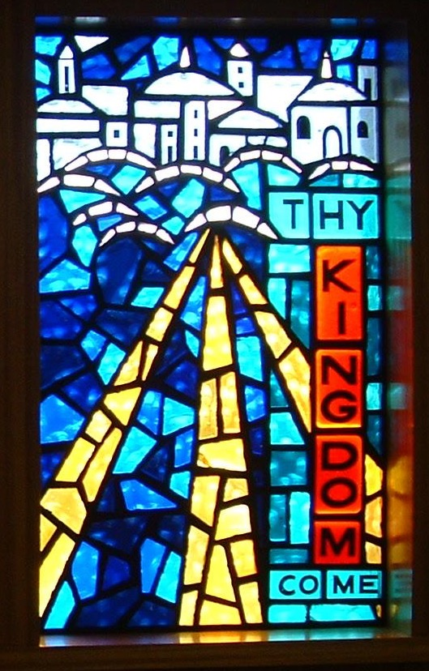
Your Kingdom Come

Slide 16
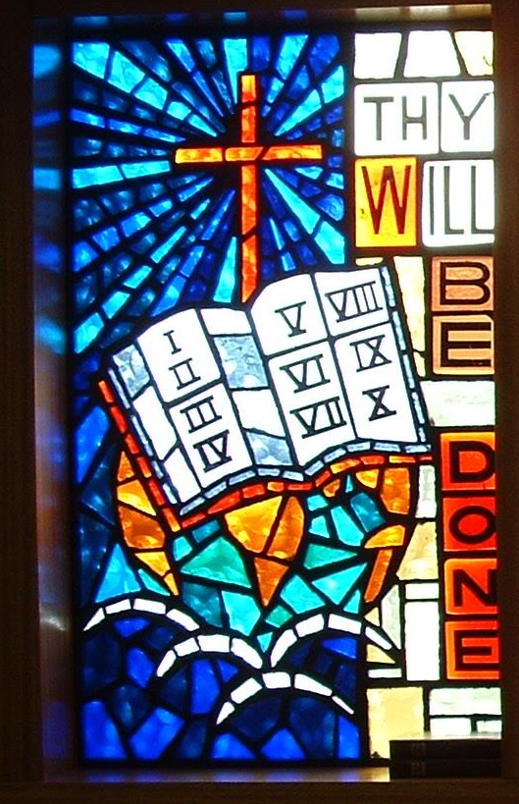
Your Will Be Done

Slide 17
Black

Slide 18
A Pattern for Prayer
II. Pray for those you influence to be protected and holy.
I. Pray that you will glorify God by fulfilling his calling for you.

Slide 19
Widening Circle of Christ's Prayer
1. Protect them (6-16)
2. Sanctify them (17-19)
James
Thaddeus
John
Peter
Andrew
For Himself
Bartholomew
James bar Alphaeus
For Disciples
Thomas
Simon the Zealot
Philip
Matthew

Slide 20
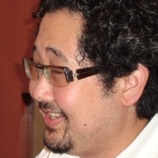
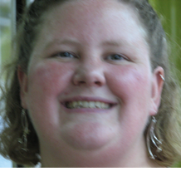
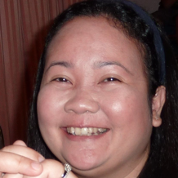
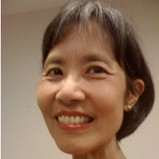
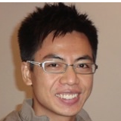
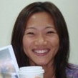
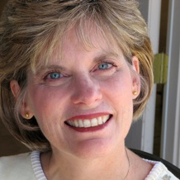
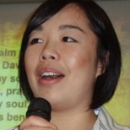
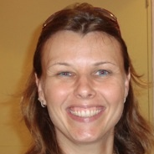
Widening Circle of Your Prayers
1. Protect them
2. Sanctify them

Slide 21
Good & Evil

Slide 22
Hebrews 5:14

Slide 23
Light overpowers the dark… EVERY TIME.

Slide 24
”I'm not asking you to take them out of the world, but to keep them safe from the evil one” (John 17:15)

Slide 25
Light dispels darkness!

Slide 26
Mocking Virginity

Slide 27
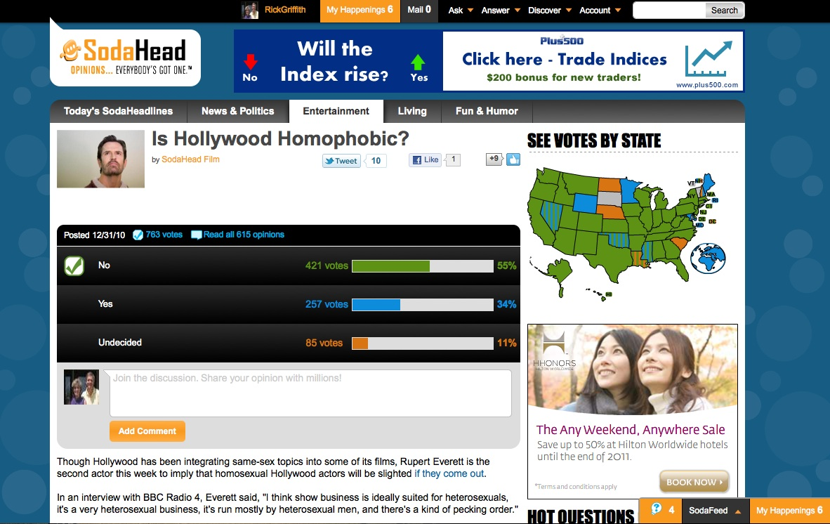
SodaHead

Slide 28
A Pattern for Prayer
II. Pray for those you influence to be protected and holy.
Unity
I. Pray that you will glorify God by fulfilling his calling for you.
III. Pray for all believers to be a united witness
to the world.

Slide 29
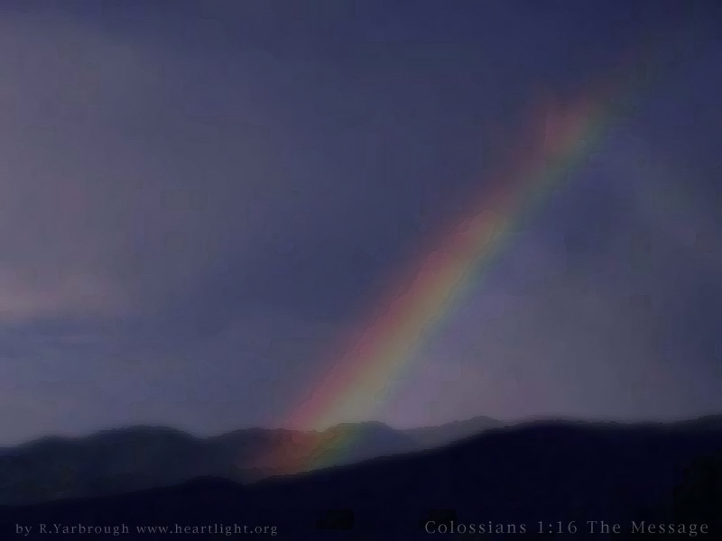
III. Pray for all believers to be a united witness to the world (17:20-26).
Unity produces more believers who can fellowship with God (20-23).

Slide 30
The Trinity
Father
is
is not
is not
GOD
is
is
Son
Spirit
is not
H. Wayne House, Charts of Christian Theology and Doctrine, p. 45

Slide 31
²¹And may they be in us so that the world will believe you sent me. ²²“I have given them the glory you gave me, so they may be one as we are one. ²³I am in them and you are in me. May they experience such perfect unity that the world will know that you sent me and that you love them as much as you love me” (21c-23).

Slide 32
Black

Slide 33
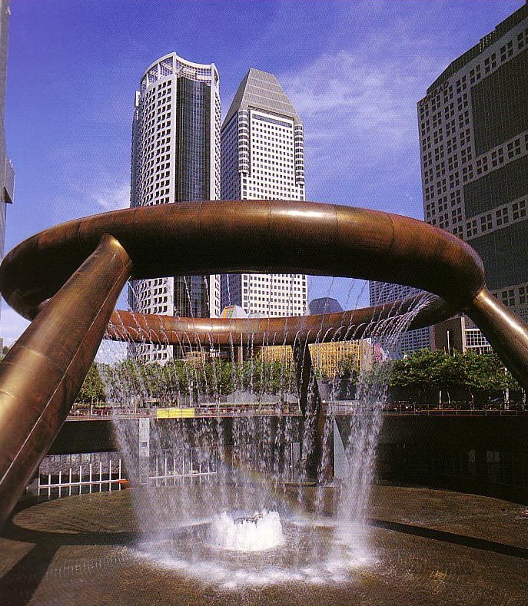
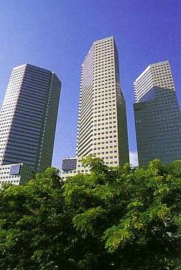
The City-State of Singapore

Slide 34
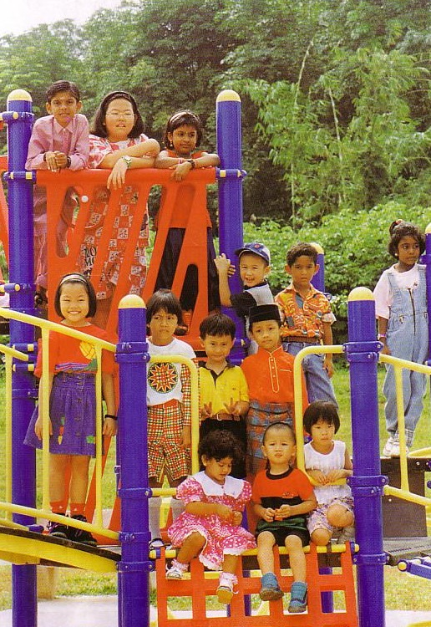
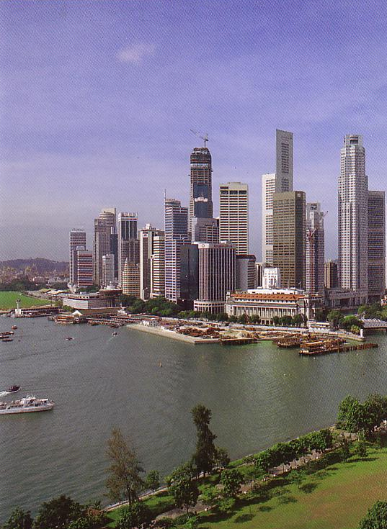
Multi-cultural * Multi-ethnic * Multi-religious
99% of Hindus are Indian
99% of Buddhists are Chinese
99% of Muslims are Malay
Only Christians effectively cross racial lines though Malays are still unreached

Slide 35
III. Pray for all believers to be a united witness to the world (17:20-26).
Unity produces more believers who can fellowship with God (20-23).
We'll be united in heaven forever--so we might as well agree now (24).

Slide 36
Black

Slide 37
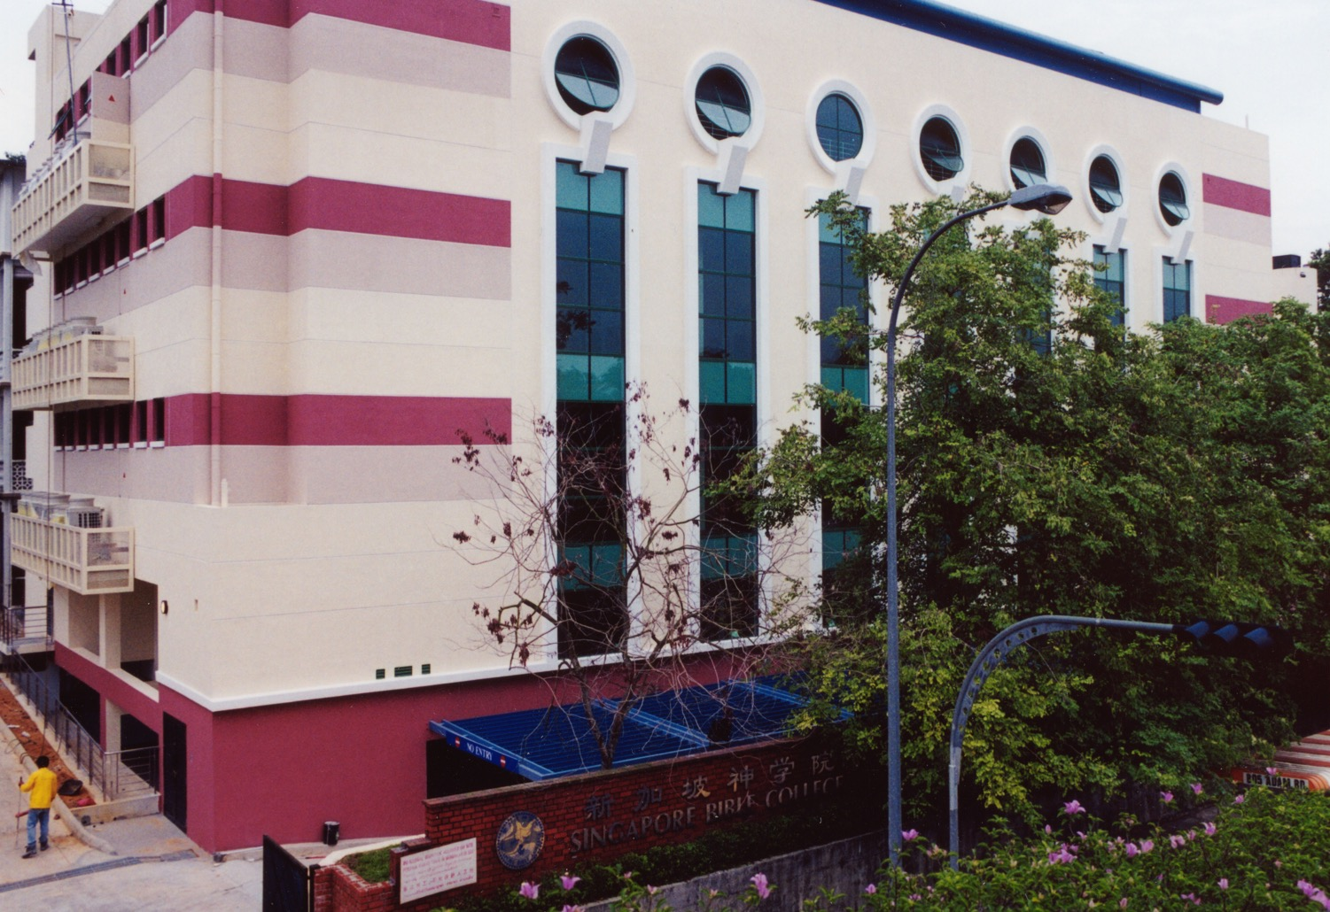
SINGAPORE BIBLE COLLEGE
Notes:
I've served as a seminary professor with 30 other faculty at Singapore's largest training school: Singapore Bible College

Slide 38
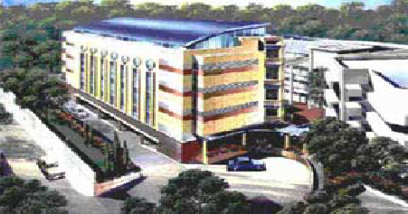
SBC Schools
Chinese
Music
Counseling
English
Established 1952
31 Full-time Faculty
500 Students
25 Denominations
25 Countries
29 Languages

Slide 39
Church Unity
When should we not work together?

Slide 40
What does 2 Cor. 6:14-7:1 mean?
“
136
“Don't team up with those who are unbelievers. How can righteousness be a partner with wickedness? How can light live with darkness? ¹⁵What harmony can there be between Christ and the devil? How can a believer be a partner with an unbeliever? ¹⁶And what union can there be between God's temple and idols? For we are the temple of the living God.”

Slide 41
What does 2 Cor. 6:14-7:1 mean?
“
136
“As God said:
'I will live in them
and walk among them.
I will be their God,
and they will be my people.
¹⁷Therefore, come out from among unbelievers, and separate yourselves from them, says the Lord'
(2 Cor. 6:16-17)

Slide 42
What does 2 Cor. 6:14-7:1 mean?
“
136
“Don't touch their filthy things,
and I will welcome you. ¹⁸And I will be your Father, and you will be my sons and daughters, says the Lord Almighty.”
¹Because we have these promises, dear friends, let us cleanse ourselves from everything that can defile our body or spirit. And let us work toward complete holiness because we fear God”
(2 Cor. 6:17–7:1)

Slide 43
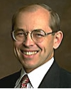
What does 2 Cor. 6:14-7:1 mean?
“
136
“The direct commands to separate from other people are always commands to separate from unbelievers, not from Christians with whom one disagrees… The are no direct New Testament commands to separate from Christians with whom one has doctrinal differences (unless those differences involve such serious heresies that the Christian faith itself is denied).”
Wayne Grudem, Systematic Theology, 877

Slide 44
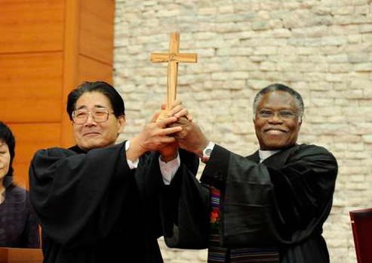
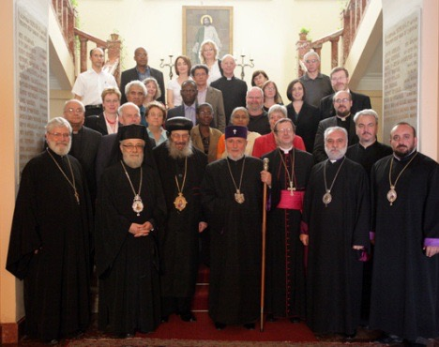
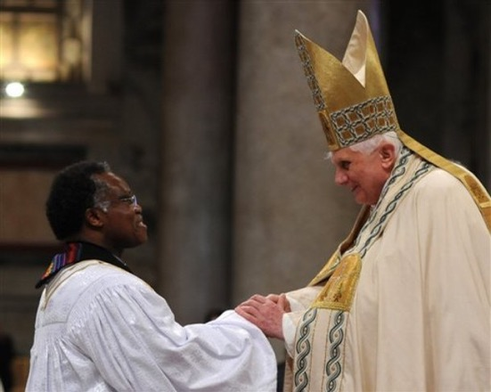
World Council of Churches

Slide 45
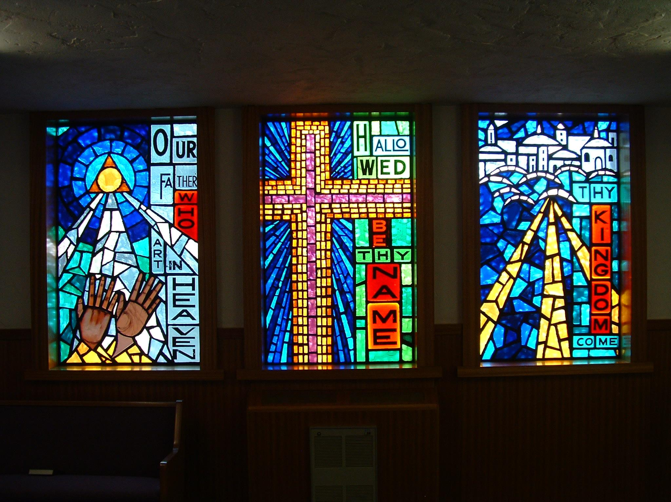
“It is better to be divided by truth than to be united by error”

Slide 46
III. Pray for all believers to be a united witness to the world (17:20-26).
Unity produces more believers who can fellowship with God (20-23).
We'll be united in heaven forever--so we might as well agree now (24).
Unity shows God's love to unbelievers so they can know Him (25-26).

Slide 47
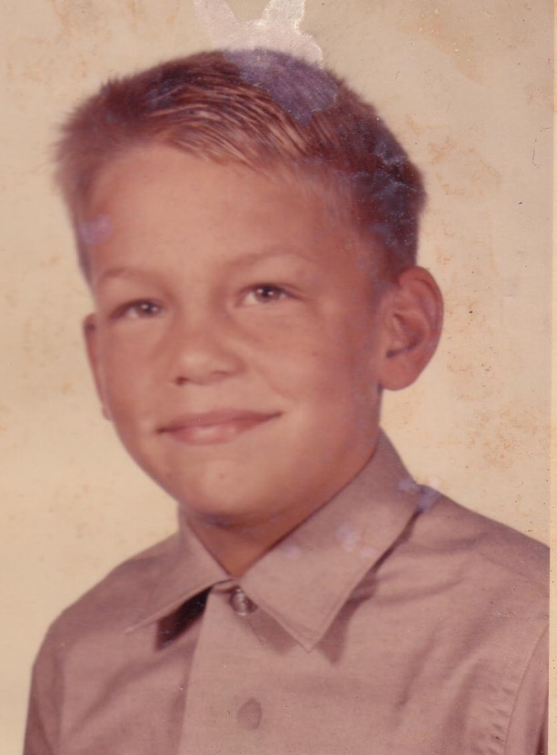
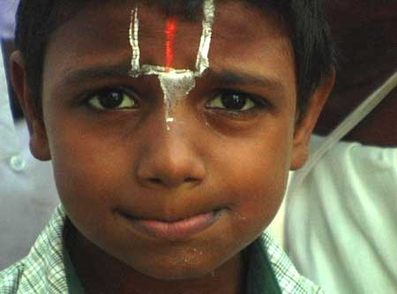
Two Boys

Slide 48
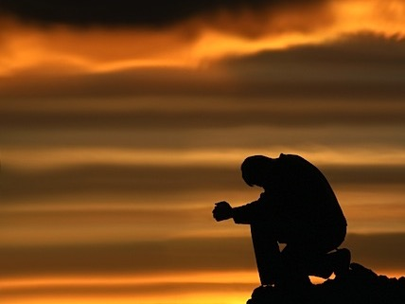
Why pray like Jesus for yourself, for those you influence, and for believers everywhere?
Main Idea
To keep an outward focus!

Slide 49
Widening Circle of Christ's Prayer
James
Thaddeus
John
Peter
Andrew
For Himself
Bartholomew
James bar Alphaeus
For Disciples
Thomas
Simon the Zealot
Philip
Matthew
For All Believers

Slide 50
A Pattern for Prayer
II. Pray for those you influence to be protected and holy.
Unity
I. Pray that you will glorify God by fulfilling his calling for you.
III. Pray for all believers to be a united witness
to the world.

Slide 51
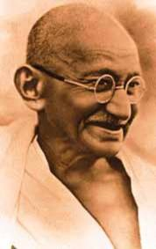
Mahatma Gandhi (1869-1948)
“I would become a Christian
—if it weren't for Christians.”

Slide 52
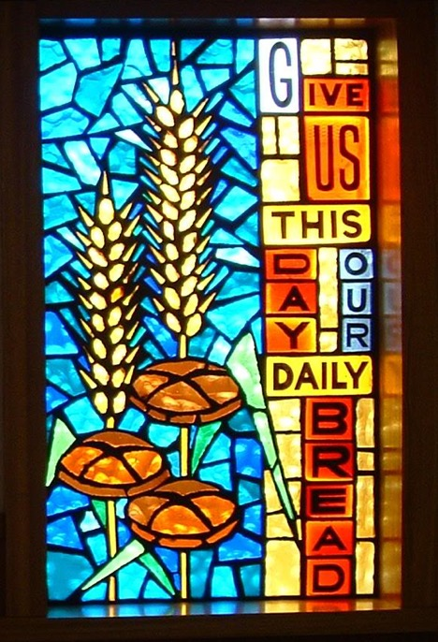
“In essentials, unity; In non-essentials, liberty; In all things, charity.”
––Philip Melanchthon

Slide 53
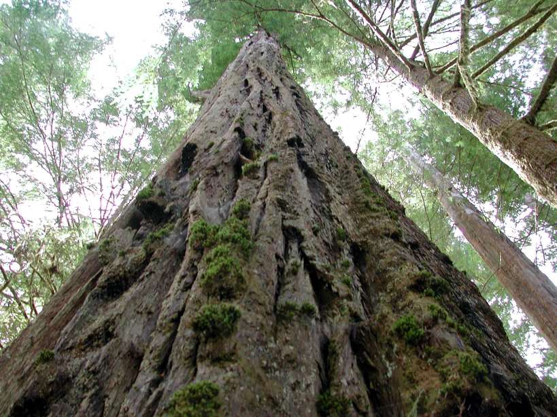
The Great Redwood Sequoias

Slide 54
The Great Redwood Sequoias

Slide 55
The Great Redwood Sequoias

Slide 56
The Great Redwood Sequoias

Slide 57
Black

